Slide 1

CONDUCTORS
It’s all about communication.

Slide 2
Agenda
Overview.
Problem!
How can we fix it?
Conductor.
Implementations.

Slide 3
Overview

Slide 4
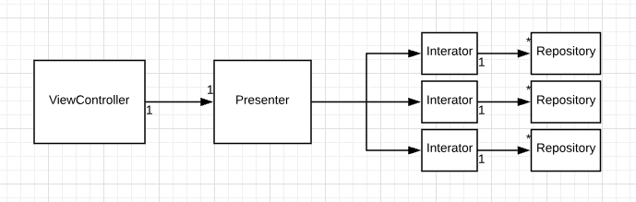
Current structure
We are using our own version of VIPER

Slide 5
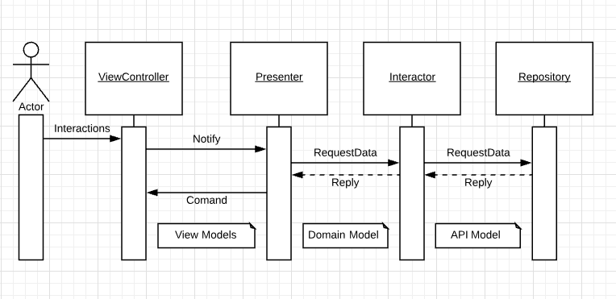
Current structure
Data flow goes like

Slide 6
Problem

Slide 7
Problem
Our problem mainly comes when:
ViewControllers are handling so many use cases.
Many use cases requires many UI components
Many UI components requires separation into stand alone components
Means that for each Component we should have (Presenter - Interactors - Repositories).

Slide 8

Problem
Easy then, lets splist and Problem Solved.

Slide 9
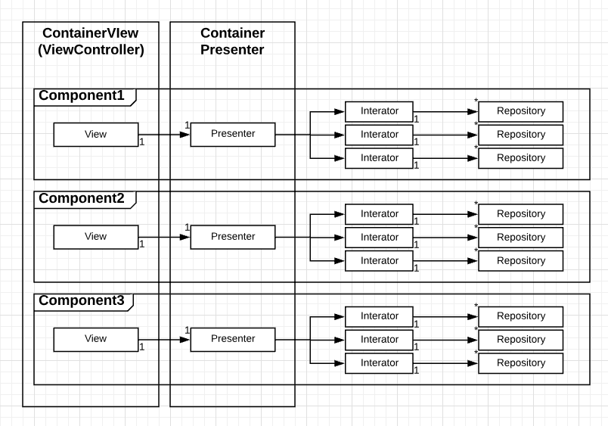
Problem

Slide 10
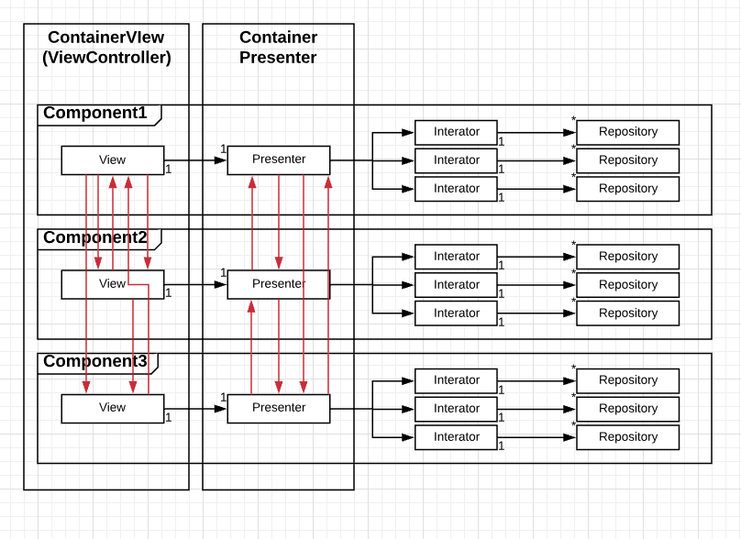
Problem
But components needs to communicates together.

Slide 11
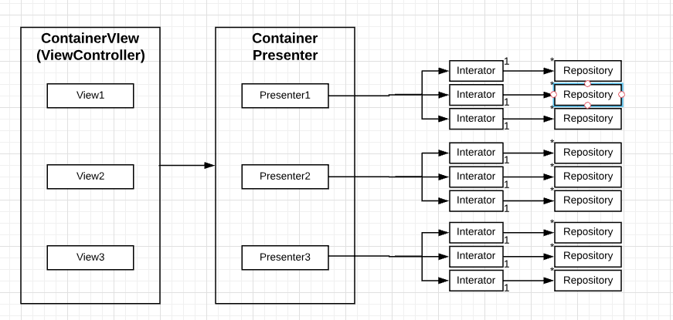
Problem
So container view / presenter is having component’s view / presenter

Slide 12
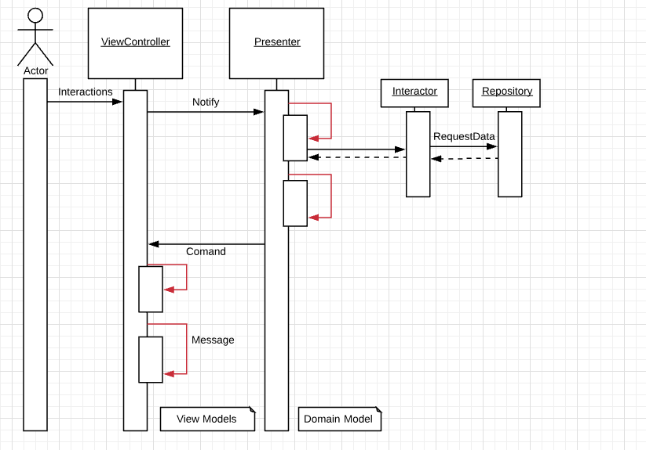
Problem
And Communication is handled by containers

Slide 13
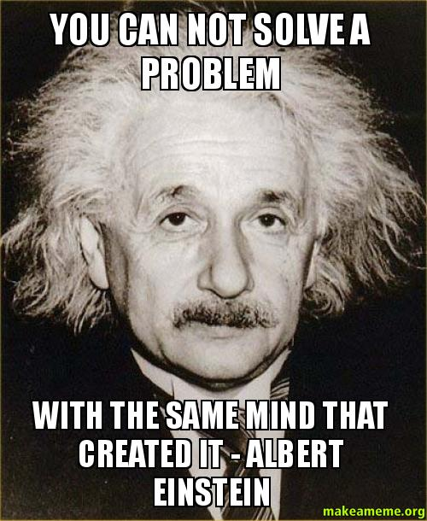

Slide 14
How can we solve it?

Slide 15
How can we solve it?
We all agree on separation of components
But it’s all about how to communicate between them.
Requirements:
We need to find a way to allow seamless communication between components
Keep components as black boxes to each others (Components are totally independent).
Make sure components are 100% reusable
Flexibility to add / remove components.
No more massive controllers / presenters.
Do we need to say the solution must be SOLID.

Slide 16
Conductor

Slide 17
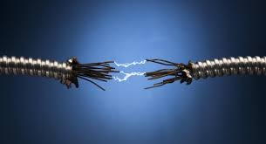
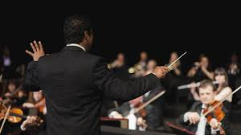
Conductor
In physics: and electrical engineering, a conductor is an object or type of material that allows the flow of an electrical current in one or more directions.
In music: a conductor is person who conducts any musical group in the performance. At the most fundamental level,
A conductor must stress the musical pulse so that all the performers can follow the same rhythm.
(Thank you Wikipedia).

Slide 18
Conductor
In this presentation: a conductor is an entity that is going to be responsible to arrange communication between different components in one screen.
A conductor is where each component’s signals are translated to a common language that all other components can understand and respond to.

Slide 19
How conductor will solve the problem
Conductor will be getting signals from components (by delegation),
Send translated signals to other components (by observation)

Slide 20
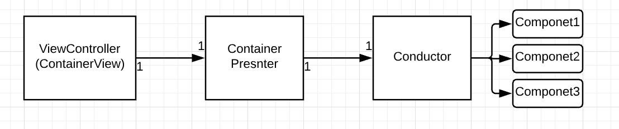
How conductor will solve the problem
Let’s keep in mind that conductor is meant to conduct the work inside the presenter.
So Conductor is actually a part of Container’s presenter

Slide 21
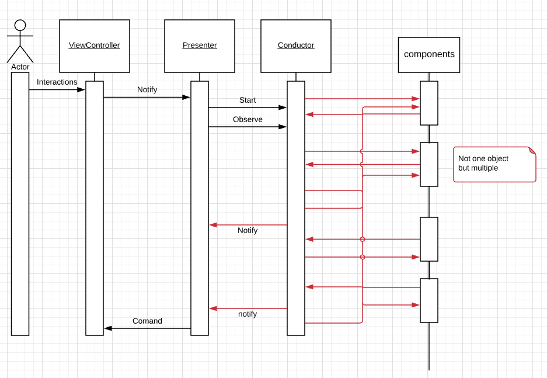
How conductor will solve the problem
Once conductor is initialized, it will be the delegate for all components → gets signals from components.
Will register components to needed events → notify components on changes

Slide 22
How conductor will solve the problem
Let’s go deeper

Slide 23
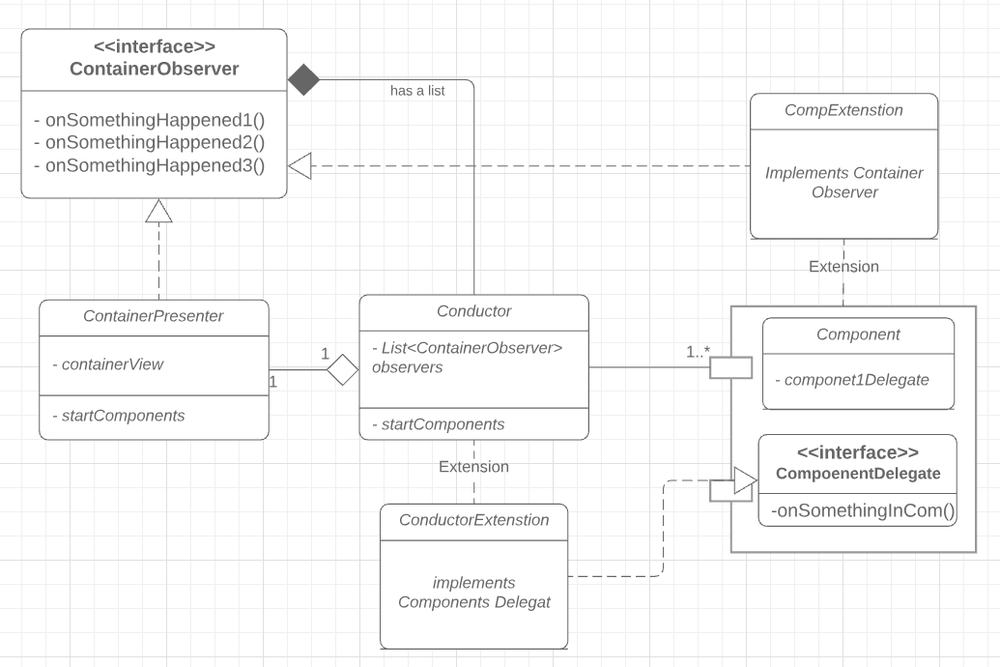
How conductor will solve the problem

Slide 24
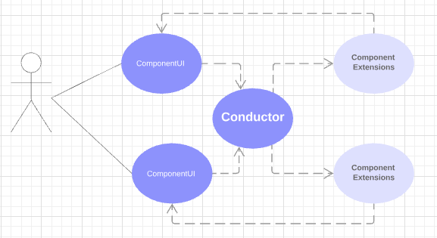
How conductor will solve the problem

Slide 25
Implementation

Slide 26
Conductor implementation
Now that it’s clear what should be the Conductor doing, let’s think about implementation.
ContainerObserver interface ? → Interface segregation broken.
Conductor is a delegate for all components ? → Open / Closed broken.
Normal EventBus ? → Will reduce readability / troubleshooting.
So we need to split the Conductor into small components and keep communication clear and readable and also make sure that the conductor is open for change closed for modification.

Slide 27
Communication Channel
CommunicationChannel will be getting signals from components and translate it to signals that could be posted to list of CommunicationChannelObservers to allow communication about a specific Component.
So:
ContainerObserver There will be no huge interface anymore, as it will be splitted to multiple communication channels
Conductor will not be the delegate to all components any more, as each CommunicationChannel will be.
It’s very readable and clear how signals flow is implemented.

Slide 28
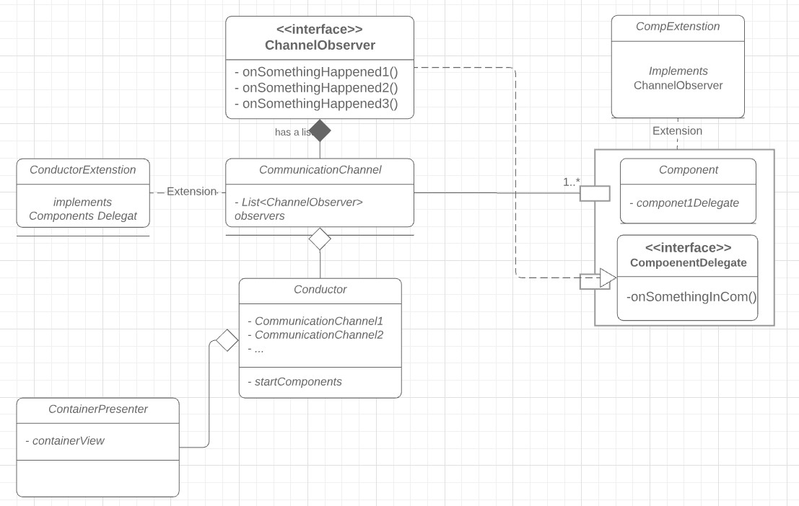
Communication Channel

Slide 29
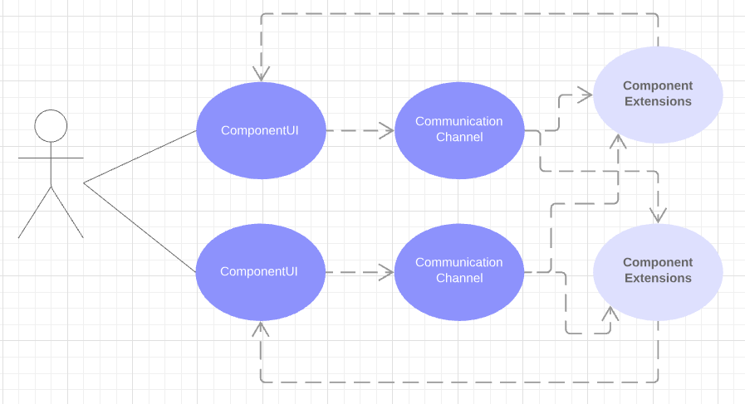
Communication Channel

Slide 30


Slide 31
Thank you!

